Slide 1
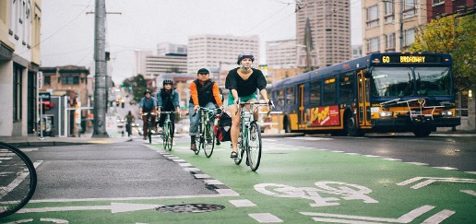
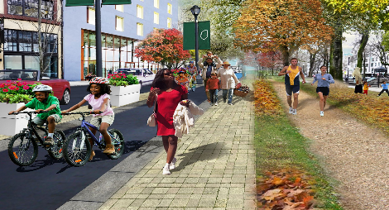
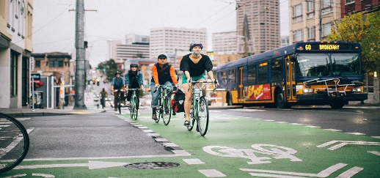



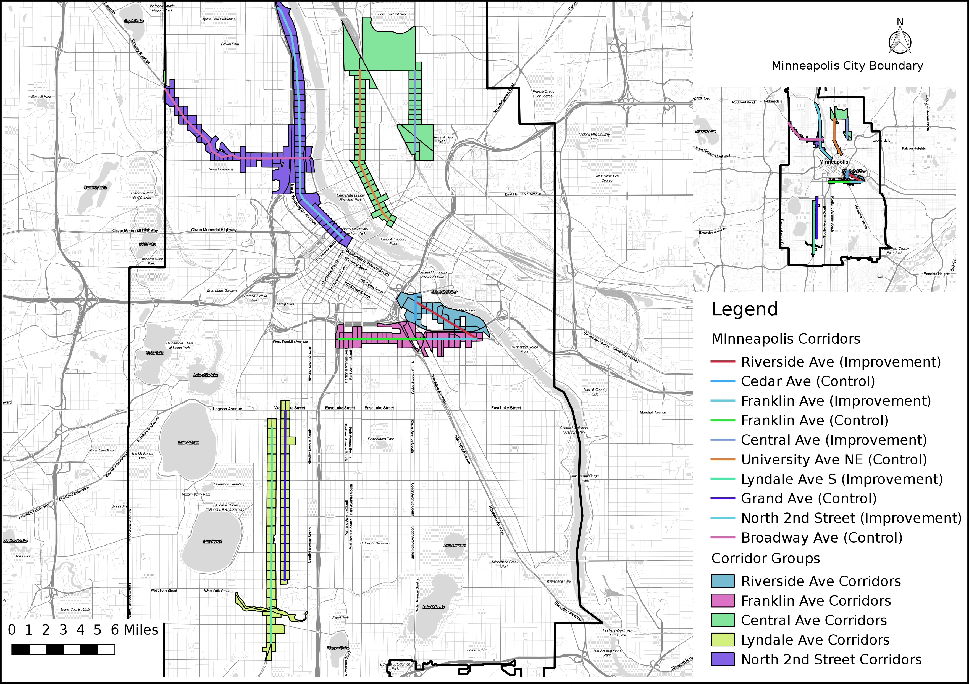
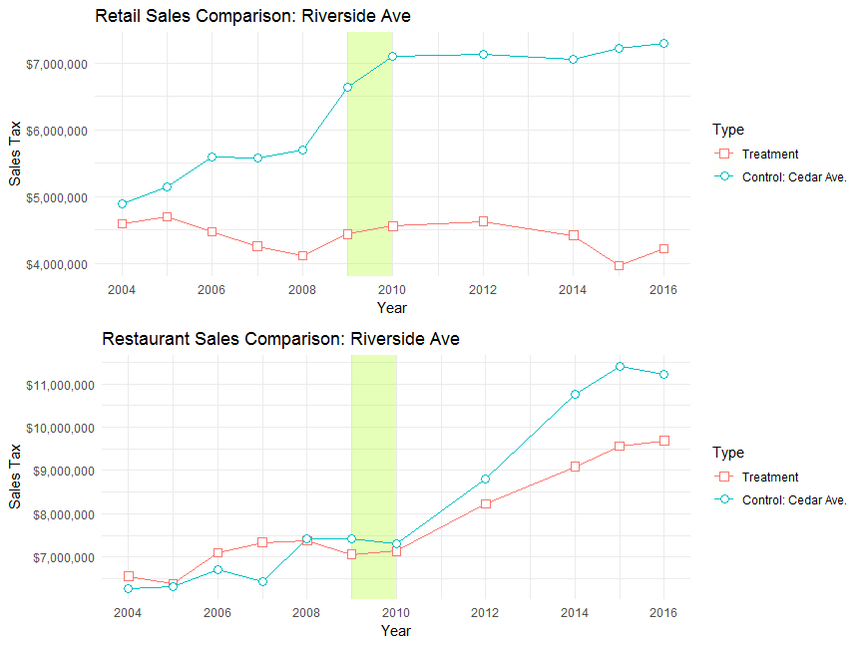
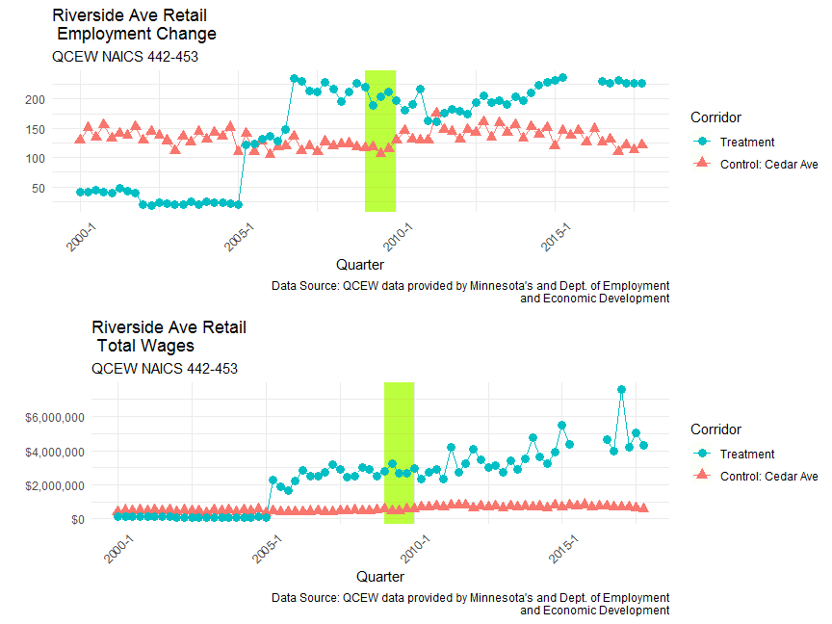



A Framework for Evaluating Economic Development Impacts of Active Transportation Improvements
Wei Shi | PhD Student
Jamaal Green| PhD Student
Jenny H. Liu, PhD | Assistant Professor
Research Goals
Design a research framework and methodology for evaluating new active transportation projects
Make the framework portable and doable for practitioners
Data Sources
LEHD LODES- Census LEHD workplace association files Retail Trade (CNS07) and Accommodation and Food Services (CNS18)
Sales Tax- Collected taxable sales from Minnesota Dept. of Revenue
QCEW- Proprietary Quarterly Census of Employment and Wages from Minnesota Dept. of Employment and Economic Development
Methodology
Corridor Selection-A Two-Stage Process
Aggregated Trend Analysis- Visually compare growth over time
Stage 1- Partner Input
Local planning partners offer candidate corridors. Corridors should be of reasonable length, primarily commercial and well traveled
Stage 2- Corridor Evaluation
Compare corridor employment percentiles, growth rates and street attributes
Difference-in-Difference
$$Y_{it}=β_{0}+β_{1}T_{it}+β_{2}A_{it}+β_{3}T_{it}A_{it}+ε_{it}$$
Interrupted Time Series
$$Y_{t}=β_{0}+β_{1}T_{1}+β_{2}X_{1}+β_{3}T_{1}X_{1}+ε_{it}$$
 | Indicator |  | Riverside | Franklin | Central | Lyndale | North 2nd
Control Corridor |  |  | Cedar | Franklin | University | Grand | Broadway
Street Type | Geographic Proximity |  | ✓ | ✗ | ✓ | ✓ | ✓
 | Street Classification |  | ✓ | ✓ | ✓ | ✓ | ✓
 | Role in Street Network |  | ✓ | ✓ | ✓ | ✓ | ✓
Business | Job Density Percentile | retail | ✓ | ✓ | ✓ | ✗ | ✓
 |  | food | ✗ | ✓ | ✗ | ✗ | ✗
 | Percent of Business Jobs |  | ✓ | ✓ | ✓ | ✓ | ✓
 | Employment Growth Rate | retail | ✓ | ✓ | ✓ | ✓ | ✓
 |  | food | ✓ | ✓ | ✓ | ✓ | ✓
Conclusion
The framework requires partnering with local experts for corridor selection and access to proprietary data
Econometric models allow for more rigorous estimate of impacts
Acknowledgements: This research is an extension of a previous project funded as part of the Portland Climate Action Collaborative, a research partnership between Portland State University’s Institute for Sustainable Solutions (ISS) and Portland Bureau of Planning and Sustainability (BPS). Many thanks to Joseph Broach, who provided us with bicycle infrastructure data. Our views do not necessarily reflect those of our sponsors and collaborators.
Contact Information: Jenny H. Liu, PhD | Assistant Professor | Toulan School of Urban Studies and Planning | Portland State University, jenny.liu@pdx.edu
Wei Shi, PhD Student | Toulan School of Urban Studies and Planning | Portland State University, shiwei@pdx.edu
Jamaal Green, PhD Student | Toulan School of Urban Studies and Planning | Portland State University, jamgreen@pdx.edu

Slide 2
Research Goal
Data Exploration
Methodology Exploration
 | Indicator |  | Riverside | Franklin | Central | Lyndale | North 2nd
Control Corridor |  |  | Cedar | Franklin | University | Grand | Broadway
Street Type | Geographic Proximity |  | ✓ | ✗ | ✓ | ✓ | ✓
 | Street Classification |  | ✓ | ✓ | ✓ | ✓ | ✓
 | Role in Street Network |  | ✓ | ✓ | ✓ | ✓ | ✓
Business | Job Density Percentile | retail | ✓ | ✓ | ✓ | ✗ | ✓
 |  | food | ✗ | ✓ | ✗ | ✗ | ✗
 | Percent of Business Jobs |  | ✓ | ✓ | ✓ | ✓ | ✓
 | Employment Growth Rate | retail | ✓ | ✓ | ✓ | ✓ | ✓
 |  | food | ✓ | ✓ | ✓ | ✓ | ✓
LEHD
QCEW
NETS
Sales tax
Corridor selection
Lessons learned
…
Economic Impact Evaluation
Trend analysis
Figure..
DID
Model..
ITS
Model…
Conclusion

